Slide 1

Student Management Database

Slide 2

Manage Student Data Effectively
The Aim
Our main motivation behind creating this database was to enable students, teachers and administration to effectively manage their data, by enabling them to use a simple GUI to do so.

Slide 3
Tech Stack
MySQL relational database
Tkinter module for Python
MySQL connector module for Python

Slide 4
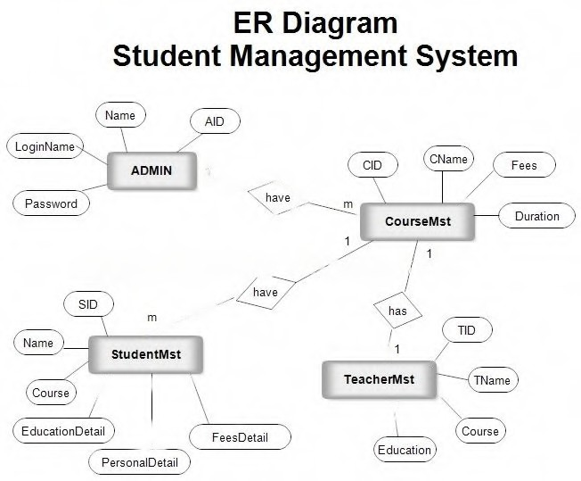

Slide 5

Download it on

Slide 6
Thank You
Harshit Singhania
2105890

